Slide 1
Unit 9
Distributed Operating System

Slide 2
Distributed System
A distributed system is a set of computers that communicate and collaborate each other using software and hardware interconnecting components.
Example:
telephone networks and cellular networks
computer networks such as the Internet
parallel computation

Slide 3
Distributed Operating System
Distributed Operating System is a model where distributed applications are running on multiple computers linked by communications.
A distributed operating system is an extension of the network operating system that supports higher levels of communication and integration of the machines on the network.
The Distributed OS involves a collection of autonomous computer systems, capable of communicating and cooperating with each other through a LAN / WAN.
A Distributed OS provides a virtual machine abstraction to its users and wide sharing of resources like as computational capacity, I/O and files etc.
Example: Windows server 2003, Windows server 2008, Windows server 2012, Ubuntu, Linux (Apache Server), AEGIS., AMOEBA, Arachne.

Slide 4
Why distributed system?
Resource sharing: It provides different mechanisms for sharing files remotely, processing information in a distributed database and performing many other operations.
Computation Speedup: processing can be done concurrently among various sites.
Reliability: In distributed system, if one site fails the remaining can continue. The failure of a site can be detected by the system, and actions must be implemented to recover from it.
Communication: communication with one another is done via a communication network to provide users with the opportunity to exchange information.

Slide 5
Advantages of Distributed OS
With resource sharing facility, a user at one site may be able to use the resources available at another.
Speedup the exchange of data with one another.
Failure of one site in a distributed system doesn’t affect the others, the remaining sites can potentially continue operating.
Better service to the customers.
Reduction of the load on the host computer.
Reduction of delays in data processing.

Slide 6
Disadvantages of Distributed OS
Security problem due to sharing.
Bandwidth is another issue if there is large data and large number of computers.
Overloading is another problem in distributed OS.
The databases in network is difficult to administrate then single user system.

Slide 7
Advantages of Distributed system over Independent PCs
Data sharing: Allow many users access to a common data base.
Device sharing: Allow many users to share expensive peripherals like color printers.
Communication: Make human to human communication easier, for example, by electronic mail.
Flexibility: Spread the workload over the available machines in the most cost effective way.

Slide 8
Hardware and Software Concepts
Hardware concepts :-
Hardware in Distributed Systems can be organized in several different ways:
Shared Memory (Multiprocessors , which have a single address space).
Private Memory (Multicomputers, each CPU has a direct connection to its local memory).

Slide 9
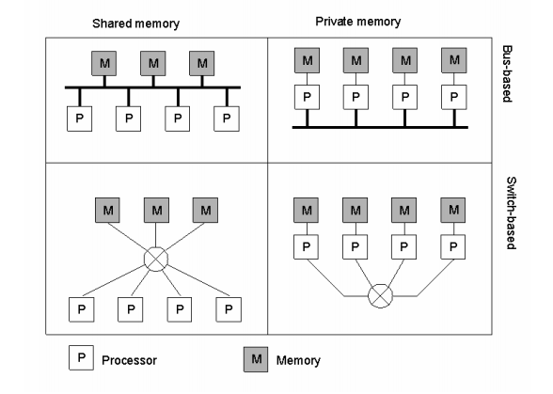
Hardware Concepts (Contd..)

Slide 10
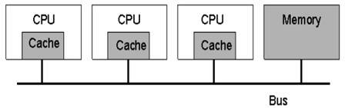
Hardware Concepts (Contd..)
Multiprocessors – Bus Based
Have limited scalability
Cache Memory help avoid bus overloading

Slide 11
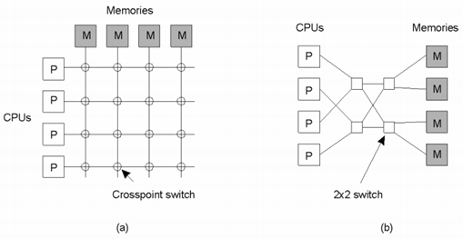
Hardware Concepts (Contd..)
Multiprocessors – Switch Based
Different CPUs can access different memories simultaneously
The number of switches limits the number of CPUs that can access memory simultaneously.
a) A crossbar switch
b) An omega switching network

Slide 12
Hardware Concepts (Contd..)
Multicomputers :-
Homogeneous:
Connected through a broadcast shared multi access network (like Ethernet) in bus based systems;
Messages routed through an interconnectionn network in switch-based multicomputers (e.g., grids, hipercubes…).
All CPUs and memory are identical;
Heterogeneous:
The most usual topology;
Computers may vary widely with respect to processor type, memory size, I/O bandwidth;
Connections are also diverse (a single multicomputer can simultaneously use LANs, Wide Area ATM, and frame relay networks);
Sophisticated software is needed to build applications due to the inherent heterogeneity;
Examples: SETI@home, WWW…

Slide 13
Software Concepts
An OS acts as a resource manager or an arbitrator : Manages CPU, I/O devices, memory
OS provides a virtual interface that is easier to use than hardware
Structure of uniprocessor operating systems: Monolithic (e.g., MS-DOS, early UNIX)
One large kernel that handles everything: Layered design
Functionality is decomposed into N layers
Each layer uses services of layer N-1 and implements new service(s) for layer N+1

Slide 14
Communication in Distributed System
There are two approaches for communication in distributed system:
Shared memory
Message passing
Shared memory:
Distributed shared memory is a form of memory architecture where physically separated memories can be addressed as one logically shared address space. Here the term shared doesn’t mean that there is a single centralized memory, but that the address space is shared

Slide 15
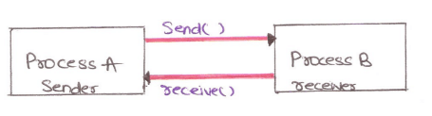
Communication in Distributed System (Contd…)
Message passing:
It refers to means of communication between
- Different thread with in a process .
- Different processes running on same node.
- Different processes running on different node.
In this a sender or a source process send a message to a non receiver or destination process. Message has a predefined structure and message passing uses two system call: Send and Receive
send(name of destination process, message);
receive(name of source process, message);
In this calls, the sender and receiver processes address each other by names. Mode of communication between two process can take place through two methods
1) Direct Addressing
2) Indirect Addressing

Slide 16
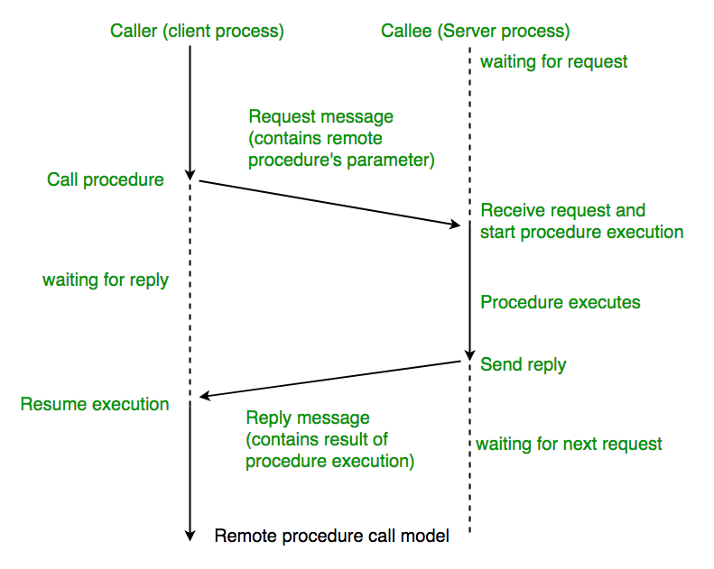
Remote Procedure Call (RPC)
Remote Procedure Call (RPC) is a powerful technique for constructing distributed, client-server based applications. It is based on extending the conventional local procedure calling so that the called procedure need not exist in the same address space as the calling procedure. The two processes may be on the same system, or they may be on different systems with a network connecting them.

Slide 17
Clock Synchronization
Distributed System is a collection of computers connected via the high speed communication network. In the distributed system, the hardware and software components communicate and coordinate their actions by message passing. Each node in distributed systems can share their resources with other nodes. So, there is need of proper allocation of resources to preserve the state of resources and help coordinate between the several processes. To resolve such conflicts, synchronization is used. Synchronization in distributed systems is achieved via clocks.
The physical clocks are used to adjust the time of nodes. Each node in the system can share its local time with other nodes in the system. The time is set based on UTC (Universal Time Coordination). UTC is used as a reference time clock for the nodes in the system.

Slide 18
Clock Synchronization (contd..)
The clock synchronization can be achieved by 2 ways: External and Internal Clock Synchronization.
External clock synchronization is the one in which an external reference clock is present. It is used as a reference and the nodes in the system can set and adjust their time accordingly.
Internal clock synchronization is the one in which each node shares its time with other nodes and all the nodes set and adjust their times accordingly.

Slide 19
Clock Synchronization (contd..)
There are 2 types of clock synchronization algorithms: Centralized and Distributed.
Centralized is the one in which a time server is used as a reference. The single time server propagates its time to the nodes and all the nodes adjust the time accordingly. It is dependent on single time server so if that node fails, the whole system will lose synchronization. Examples of centralized are- Berkeley Algorithm, Passive Time Server, Active Time Server etc.
Distributed is the one in which there is no centralized time server present. Instead the nodes adjust their time by using their local time and then, taking the average of the differences of time with other nodes. Distributed algorithms overcome the issue of centralized algorithms like the scalability and single point failure. Examples of Distributed algorithms are – Global Averaging Algorithm, Localized Averaging Algorithm, NTP (Network time protocol) etc.

